Slide 1
Layout Design Rules
ELCC442 Integrated VLSI Circuit Design
Eng. Nasser Otayf

Slide 2
Introduction
Very Large Scale Integration(VLSI) is a process where integrated circuits are made through a combination of thousands of MOS transistors into a chip.
The design of VLSI incorporates several techniques like:
    Standard Cells
    Full-custom design
    Gate-arrays
In this presentation, we shall discuss the design rules of VLSI using full custom design and standard cells. We shall also identify layout steps involved in VLSI.

Slide 3
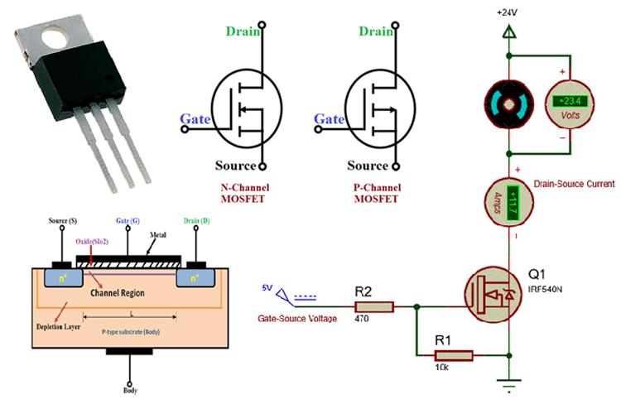
Standard Cell design
Standard cell design involves the creation of a circuit by connecting wires between the standard cells.
Standard cells are layouts of logic elements like gates and flip-flops, that can be used in the design of a chip(Uyemura, 2016).
Custom design involves cell design by ensuring MOSFETS are used in the lowest level.

Slide 4
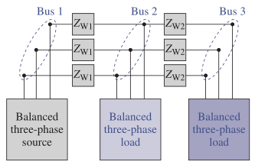
Guidelines for Standard Cell design
The following guidelines are used in standard cell design
Ensure the availability of cell input and output on either side of a cell at an equivalent horizontal distance.
Ensure that the cells are supplied with power and ground using horizontal runs of metal.
Ensure that power busses and ground line ups are to be placed end to end to ensure cell height is constant

Slide 5
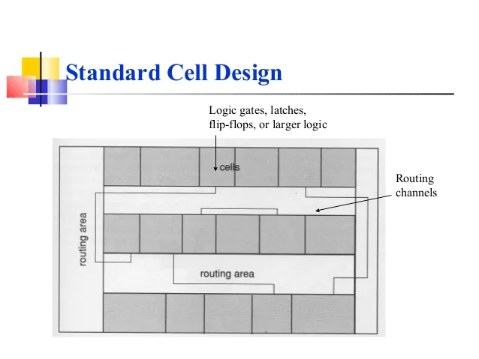
Guidelines for Standard Cell design Cont’d
Ensure a clear label of power, ground, input, and output connections on the layout.
Ensure that the layout size is small
Signal routing is an important consideration when laying out cells.

Slide 6
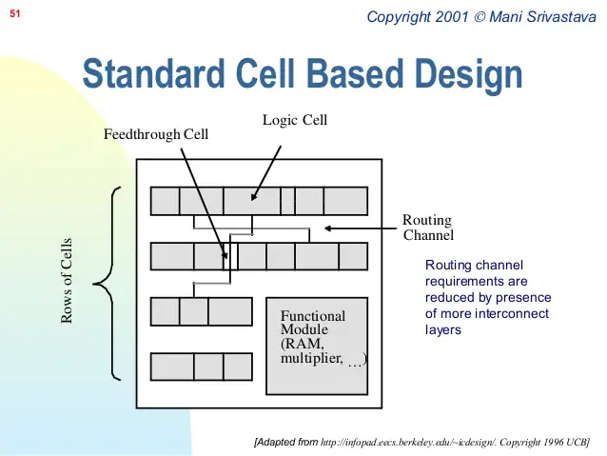
Guidelines for Standard Cell design Cont’d
Regularity
A VLSI design should have an orderly cell arrangement.
Chip floor plans should be drawn as the first step for designing a chip.
Power and ground connections
Failure to distribute power and ground properly leads to noise coupling in a given circuit. This coupling leads to noise being injected from one circuit to the other (Kerth, 2018)

Slide 7
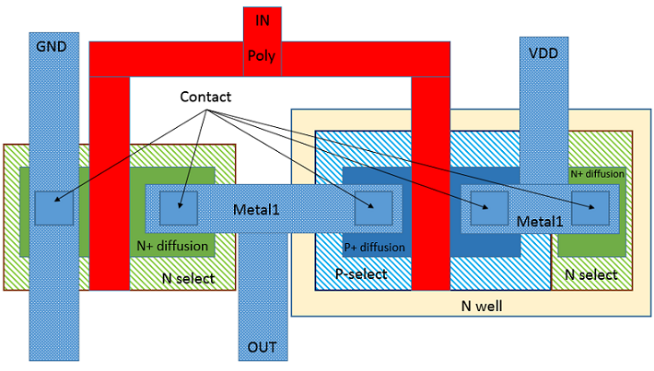
VLSI Layout Steps
The steps involved in rendering a given schematic diagram to its physical layout include:
Plan the layout
Place the elements
Polish the circuit
Verify

Slide 8
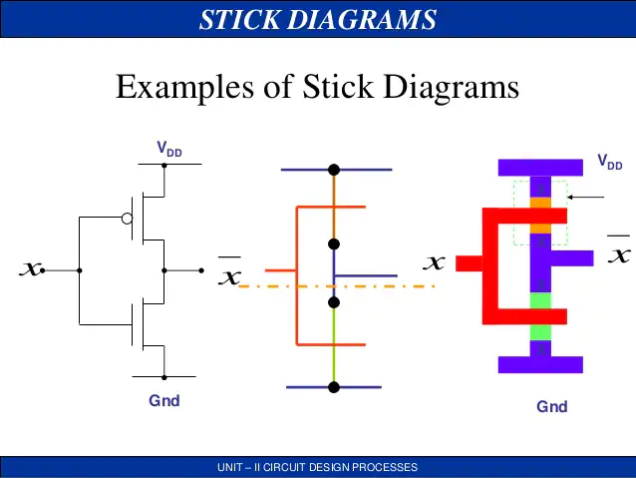
VLSI Layout Steps Cont’d
Planning and stick diagrams
When drawing floor plans to distinguish objects, one has to use different pencil colors.
Stick diagrams involve the use of pencil and paper tools to plan the cell layout(Saint, 2017).
Conductors and devices are represented using lines to assemble the actual layout in a stick diagram

Slide 9
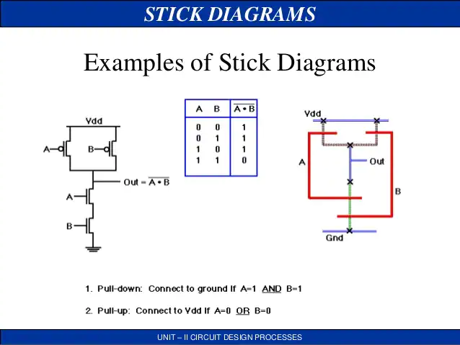
VLSI Layout Steps Cont’d
2. Device placement
Using stick diagram rules, one places the devices where needed.
Some stick diagrams rules include:
Electrical contact is denoted when the same stick types are in contact.
When different stick types are in contact or cross each other, there is no form of electrical contact.
A transistor in a stick diagram is represented when a poly crosses diffusion (Clein, 2019).

Slide 10
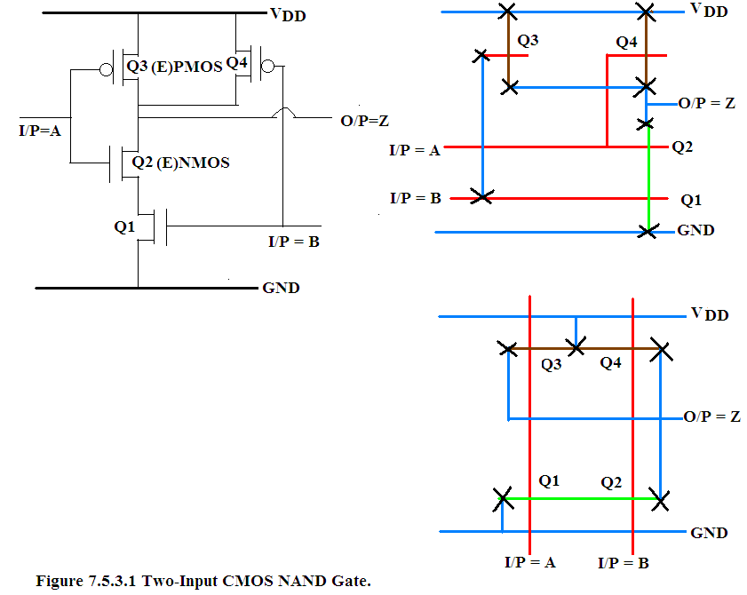
VLSI Layout Steps Cont’d
3. Polish
When you have finished placing all your devices, one ought to review the layout
Check if the hook-up is straight foreword
Check the space between contacts and poly gates and ensure its minimum
Check if there are enough contacts
Share all the sources and drain implants
Check for sufficient substrate ties

Slide 11
References
Clein, D. (2019). CMOS IC Layout: Concepts, Methodologies, and Tools, . New York: Newnes Publishers.
Kerth, D. A. (2018). Floor planning. New York: Crystal Semiconductor, Inc.
Saint, C. S. (2017). IC Mask Design: Essential Layout Techniques, . New York: McGraw-Hill.
Uyemura, J. P. (2016). Introduction to VLSI Circuits and Systems, . New York: John Wiley and Sons.

